Slide 1






MEASURES OF DISPERSION (VARIANCE, STANDARD DEVIATION, RANGE, IQR)
AZEEZ AREGBESOLA
BEYOND THE NUMBERS

Slide 2




MEASURES OF DISPERSION (VARIANCE, STANDARD DEVIATION, RANGE, IQR)
WHILE CENTRAL TENDENCY (MEAN, MEDIAN, MODE) TELLS US THE "TYPICAL" VALUE, DISPERSION TELLS US HOW SPREAD OUT THE DATA IS.
THIS POST WILL COVER:
Concept Introduction – What are measures of dispersion, and why do they matter?
Real-World Example – A fresh dataset showing how data spreads.
Simplified R Code – Step-by-step implementation.
Visualization – A boxplot illustrating dispersion.
Key Takeaways – Summary.
AZEEZ AREGBESOLA
BEYOND THE NUMBERS

Slide 3




CONCEPT INTRODUCTION
MEASURES OF DISPERSION: UNDERSTANDING DATA SPREAD!
Why is this important?
Finance: How risky is an investment? 📈
Education: How varied are student test scores? 🎓
Manufacturing: How consistent is product quality? ⚙️
Key dispersion measures:
✅ Range – Difference between max and min values
✅ Variance – The average squared deviation from the mean
✅ Standard Deviation (SD) – How much data varies from the mean
✅ Interquartile Range (IQR) – Spread of the middle 50% of the data
AZEEZ AREGBESOLA
BEYOND THE NUMBERS

Slide 4




REAL-WORLD EXAMPLE
IMAGINE YOU’RE ANALYZING DELIVERY TIMES (IN MINUTES) FOR TWO DIFFERENT COURIERS.
GOAL
SOLUTION
CHALLENGE
✅ Goal: Determine which courier service is more consistent.
✅ Challenge: Both couriers may have similar average delivery times, but one could be less reliable due to high variability.
✅ Solution: Compare dispersion metrics to assess consistency.
AZEEZ AREGBESOLA
BEYOND THE NUMBERS

Slide 5

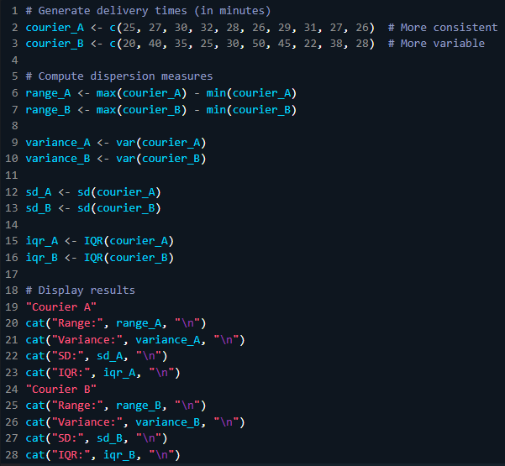
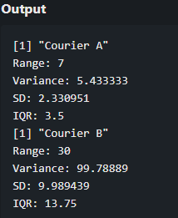
R IMPLEMENTATION
WE’LL GENERATE SYNTHETIC DELIVERY TIME DATA AND COMPUTE DISPERSION MEASURES.
AZEEZ AREGBESOLA
BEYOND THE NUMBERS

Slide 6
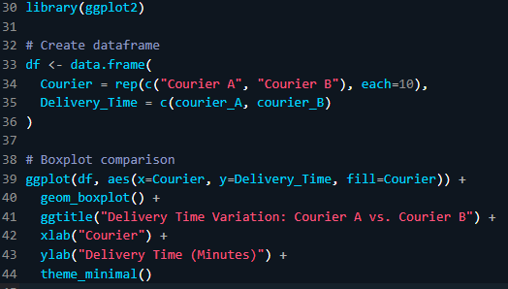
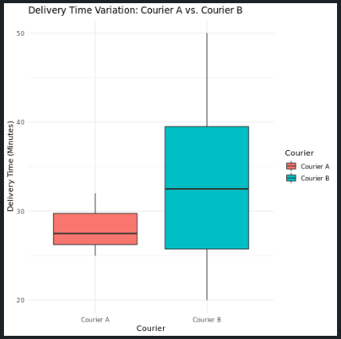
R IMPLEMENTATION
LET’S VISUALIZE DELIVERY TIME VARIATION WITH A BOXPLOT.
📌 COURIER A (LEFT) HAS A TIGHTER BOX, MEANING DELIVERIES ARE MORE CONSISTENT.
📌 COURIER B (RIGHT) HAS A WIDER SPREAD, INDICATING HIGH VARIABILITY IN DELIVERY TIMES.
AZEEZ AREGBESOLA
BEYOND THE NUMBERS

Slide 7



KEY TAKEAWAYS
SUMMARY
✅ Lower variance & standard deviation = More consistent data.
✅ IQR is useful for detecting outliers & understanding middle-range variation.
✅ A small range doesn’t always mean consistency; look at variance & SD for deeper insights.
AZEEZ AREGBESOLA
BEYOND THE NUMBERS

Slide 8


FROM DATA TO DECISIONS
AZEEZ AREGBESOLA
BEYOND THE NUMBERS

